Slide 1

Nawy
Qualified leads
Prepared by:
Mohamed Ahmed Abdelmaguid

Slide 2
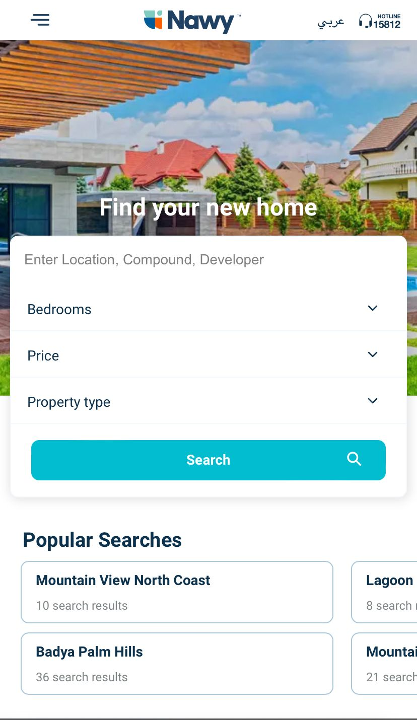
Motivation
Nawy is a one-stop-shop that will provide you with the key to your new home by presenting all the necessary information and helps you make an informed decision via reliable brokers. Users are able to search for available units by selecting criteria that match their needs. We are partnered with all the big real estate developers. Our team includes experienced real estate brokers that facilitate the transaction.
There is a lack of information in the Egyptian real estate market. Making an informed decision requires time-consuming manual work and comparing between available options is a difficult task. This creates an unnecessary time burden and leads to incorrect decision making when buying/selling properties. Brokers in Egypt have a bad reputation and are perceived to be untrustworthy.
Notes:
Over 50% of Airbnb guests choose to stay at an Airbnb over a traditional hotel.
In some U.S. markets, Airbnb can be 6% to 17% cheaper than hotels.
400,000 companies directly engage with Airbnb to manage travel for their employees.

Slide 3
Agenda
Objectives
Data Understanding
Data Pre-processing
Challenges
Data Exploration & Hypothesis testing
Data Preparation
Handling non-realistics data, outliers and missing values.
Feature Selection
Feature Engineering
Model Selection & Evaluation metric
Fine-Tune the model
Hyperparameters Optimization
Feature Importance selections
Results
Other Approaches
Deployment
Business Recommendations

Slide 4
Objectives

Slide 5
Objectives
Business Challenge :
In Nawy we are initiating targeting campaigns on a daily basis to generate Real estate leads,
The main pain is generating qualified leads.
Can we predict if the received leads has low qualified and high qualified leads?
Project Aim :
The first objective of this project is to recognize key factors that will use to know qualified lead.
The second one is to develop a to classify the received leads into two categories: low qualified and high qualified leads..

Slide 6
Dataset Understanding

Slide 7





Data understanding
The following data was provided.
For the leads
Customer names and their mobile network, message
Method of contact, AD group, locations they search for, and campaign
Data Dates: from 2019 to 2022

Slide 8
Challenges
The data was not enough to solve our problems.
Many unique values in features
A lot of missing and incorrect data
The model doesn’t get better with more examples.
Data Highly skewed

Slide 9
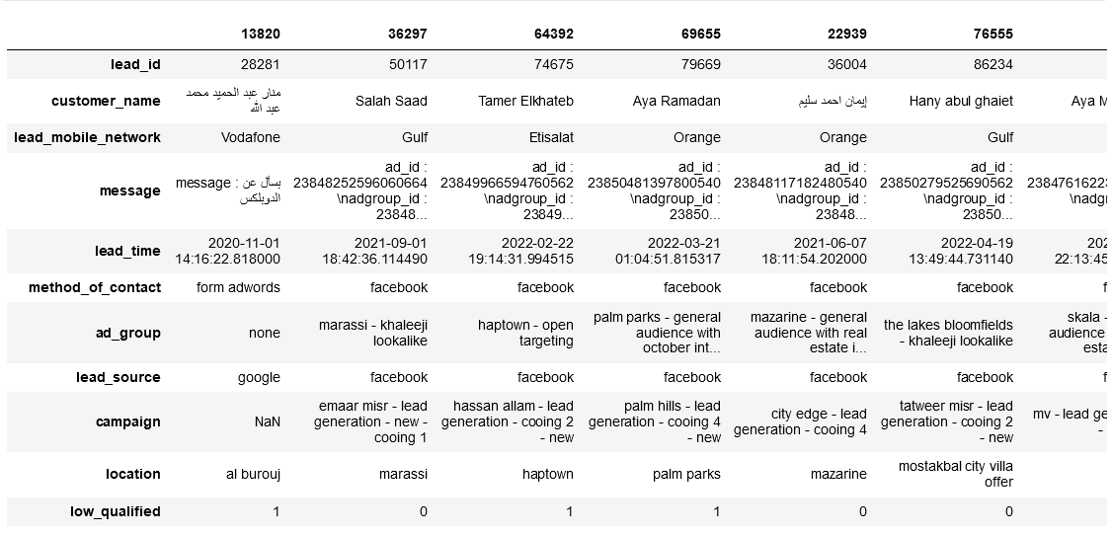
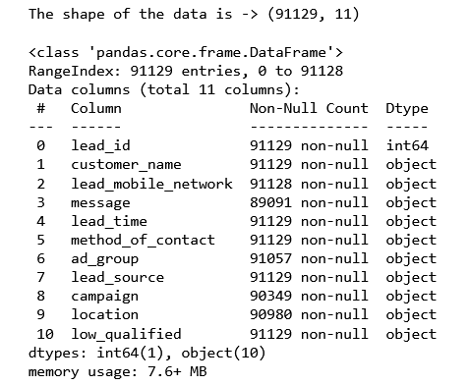
Data Pre-processing
Leads dataset:

Slide 10
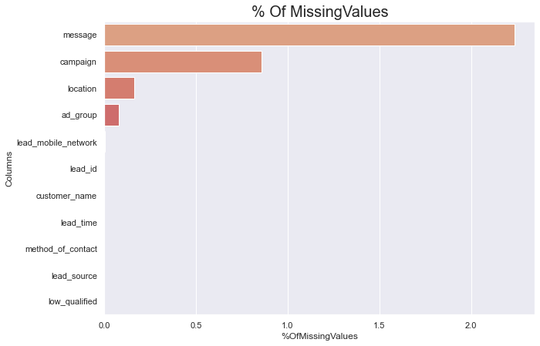
Data Pre-processing -cont
Dropped NaN values
Dropped all sample
have ID 69334 and 75772
due to their was testing not real data
Dropped customer name feature
Minimize number for unique value by clustering similar values together
Fixed all the data types
Using NLP techniques : to extract message , and clean features like location, ad_group, and camping
Drop unrealistic values
Relacing NaN with ‘-unknown-’.

Slide 11
Data Exploration & Hypothesis testing

Slide 12
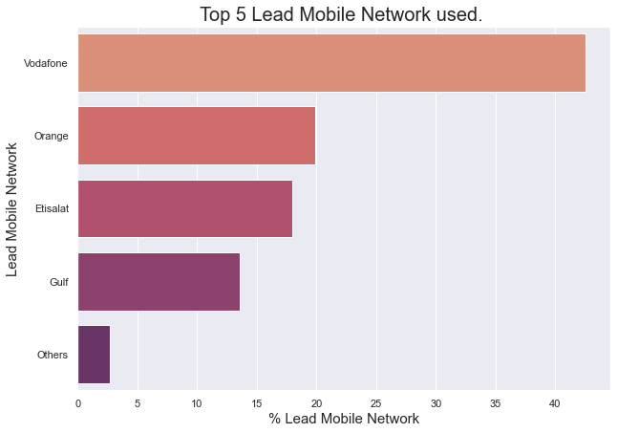
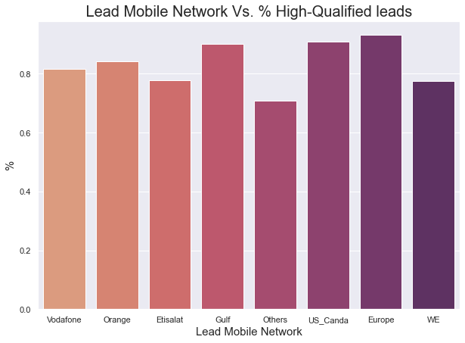
Data Exploration & Hypothesis testing
Leads dataset:
Lead Mobile Network
From first look, it appears than Vodafone has highest leads but Europe & gulf have the highest quality
Around 80.4% of leads used a Vodafone and Etisalat, and Orange.
We have noticed that Vodafone user leads are more than twice as many as Etisalat, and Orange user leads used.
An interesting insight is that Vodafone network are extremely popular.
Notes:
Around 90% of action types is view and data and click

Slide 13
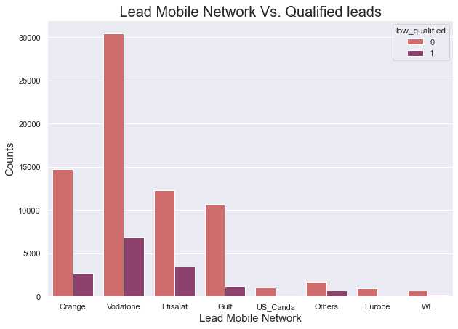
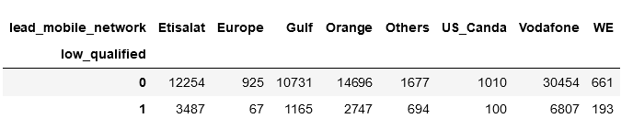


Data Exploration & Hypothesis testing - cont
Leads dataset:
Lead Mobile Network
Is there a relationship between Qualified leads and the Lead Mobile Network of the user?
H0: No relationship between Qualified leads and the Lead Mobile Network of the user.
H1: There is a relationship between Qualified leads and the Lead Mobile Network of the user.
We will assume our significance level, to be 0.05.
Notes:
Around 90% of action types is view and data and click

Slide 14
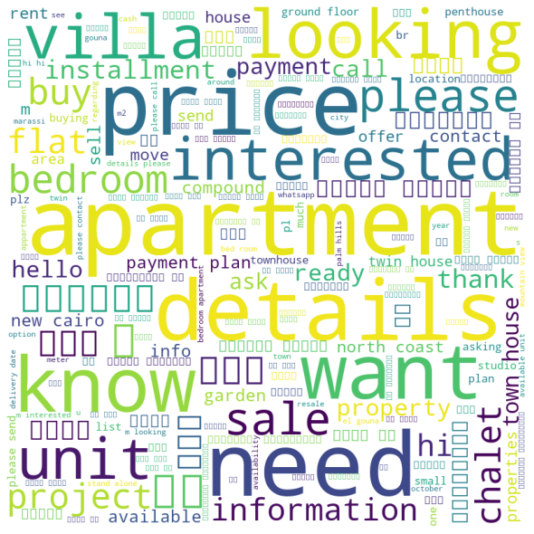
Data Exploration & Hypothesis testing - cont
Leads dataset:
Message for High-Qualifed
We noticed high qualified lead ask more specific relate to real estate like apartment or villa or bedrooms, chalet
Notes:
Around 90% of action types is view and data and click

Slide 15
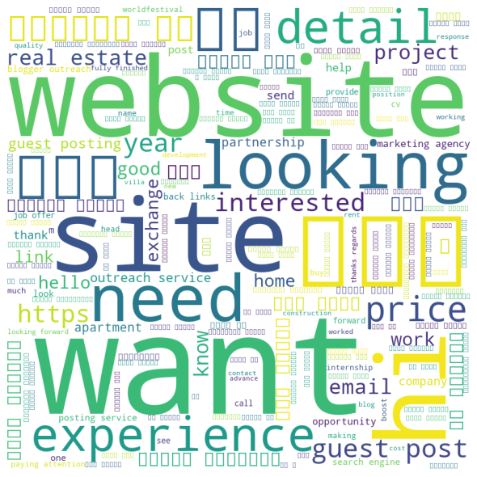
Data Exploration & Hypothesis testing - cont
Leads dataset:
Message for Low-Qualifed
We noticed low qualified lead is more looking or just checking
Notes:
Around 90% of action types is view and data and click

Slide 16
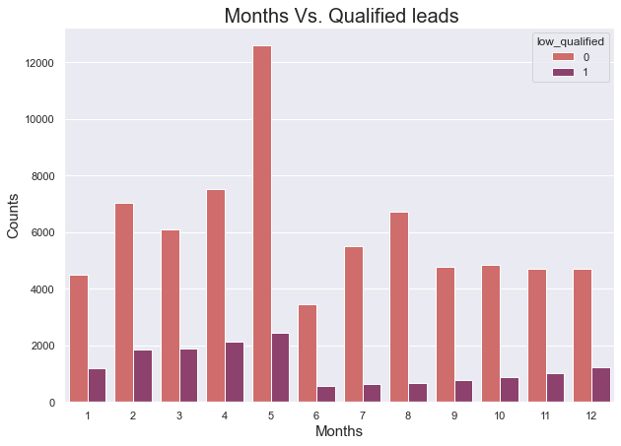
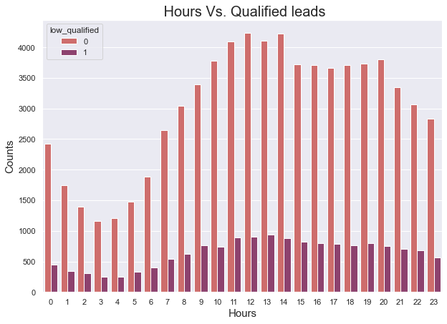
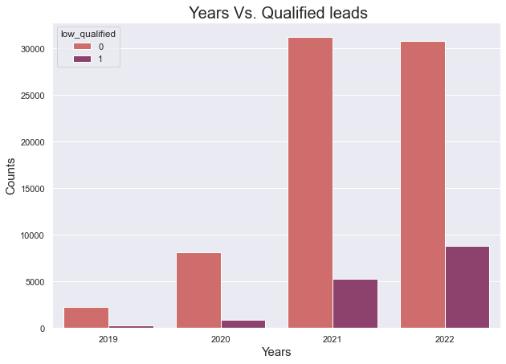
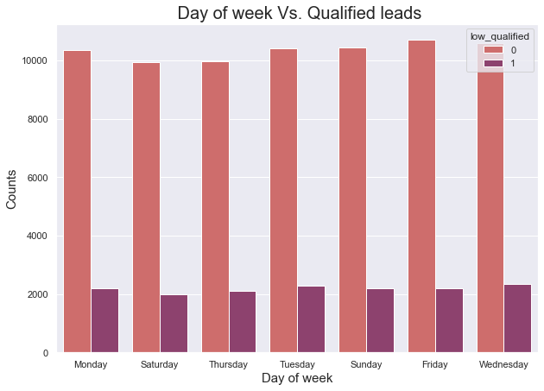
Data Exploration & Hypothesis testing - cont
Leads dataset:
Time of lead
We made hypothesis testing for all these new features to see if contribute for decide the quality of leads

Slide 17
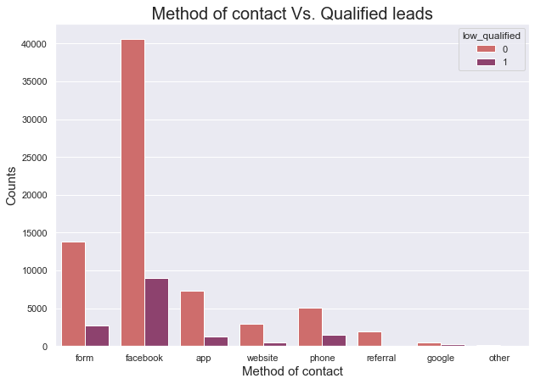
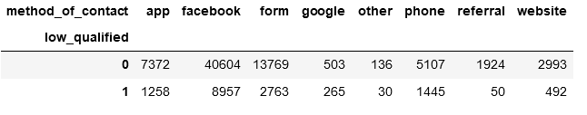
Data Exploration & Hypothesis testing - cont
Leads dataset:
Method of contact
Is there a relationship between Qualified leads and the method of contact of the user?
H0: No relationship between Qualified leads and the method of contact of the user.
H1: There is a relationship between Qualified leads and the method of contact of the user.
We will assume our significance level, to be 0.05.
Notes:
around 60% of the users did not end up booking any trip represented by NDF.
A majority of users booked a destination in US around 30% considering that user population in this problem is from US. Thus, my inference is that US travelers tend to travel within US itself.

Slide 18
Data preparation

Slide 19
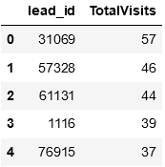
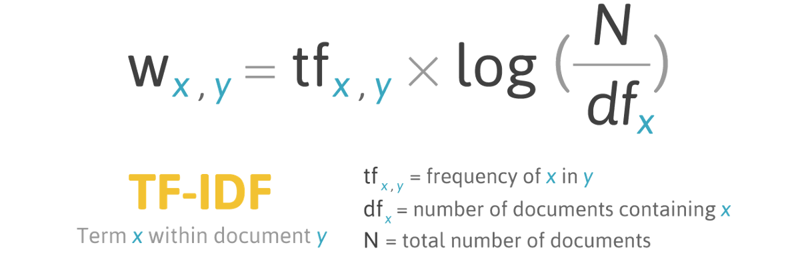
Data preparation
Leads dataset:
Filling NaN with Unknown
Extract year and month and day of the week , hour from Date features
Calculated the sum of totals of visits of one user
Combine Location, ad_group, and campaign to one column
then use as text to try to find pattern by TF-IDF

Slide 20
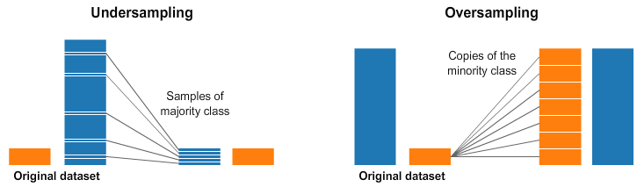
Data preparation
Leads dataset:
Using undersampling and oversampling techniques to solve imbalanced data
And undersampling approach works better

Slide 21
Model Selection

Slide 22
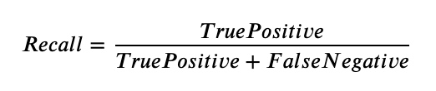
Model Selection & Evaluation metric
Data was trained on three tree-based classification models to find out which best fit and know our baseline:
XGBoost classifier
Decision Tree
Random Forest
Evaluation Metric : Recall
I choose recall as an Evaluation metric because we care more about not miss classifying
high-qualified leads as low-qualified False Positives, we will use metric recall as a guidance that our model works well business-wise.

Slide 23
Model Selection & Evaluation metric
Results
Model | Train Score | Test Score
Decision Tree | 100% | 62%
Random Forest | 100% | 72%
XGBoost | 83% | 74%

Slide 24

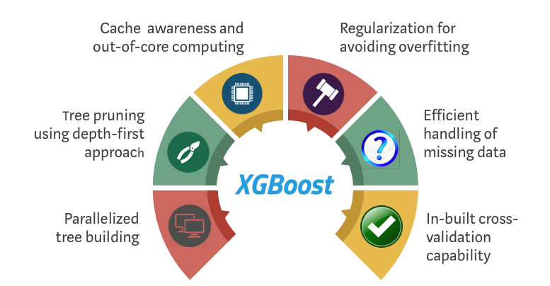
Model Selection & Evaluation metric
Why XGBoost

Slide 25
Fine -Tune
the Model

Slide 26
Fine-tune the model
Hyperparameter | values | Best
'Max_depth' | sp_randint(3, 20) | 9
'Learning_rate' | 0.001, 0.01, 0.1, 0.2] | 0.001
'Gamma' | [0, 0.25, 0.3,0.35,0.45,0.5,0.6,0.8,1.0] | 0.8
'Reg_lambda' | [0, 0.25, 0.3,0.35,0.45,0.5,0.6,0.8,1.0] | 1.0
'Subsample' | [0.5, 0.6, 0.7, 0.8, 0.9, 1.0] | 0.7
'Min_child_weight' | [0.25,0.5, 1.0, 3.0, 5.0, 7.0] | 0.5
'N_estimators' | [100,200,500,1000,2000] | 500
'Colsample_bytree' | [0.1,0.3,0.5,1] | 1

Slide 27
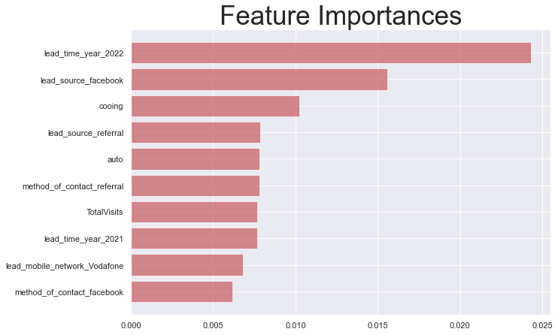
Fine-tune the model - cont
Top Features

Slide 28
Results
383
383
865
Result before selecting important features and fine-tuning
Features : 865
Recall : 74 %
Result after selecting important features and fine-tuning
Features : 383
Recall : 79 %

Slide 29
Deployment

Slide 30

Deployment
383
383
Used Flask API and HTML Template.
Exposing different APIs to generate predictions for sales department, by passing info about the lead and display if it high or low qualified.

Slide 31
Other Approaches
Use deep learning model to capture more hidden patterns.
Try another classical model has class weight to solve imbalance data

Slide 32
Business Recommendations

Slide 33
Business Recommendations
Collect more information from the user like his/her work, location, gender, age , education, total visits, device.
Improve the data engineering pipeline to reduce the incorrect and missing values.
Reduce if the capability of users to write like their location rather than choose from references we give them like cities or zones.

Slide 34
THANK YOU!

